Slide 1
Tut 8
Jingyu Li

Slide 2
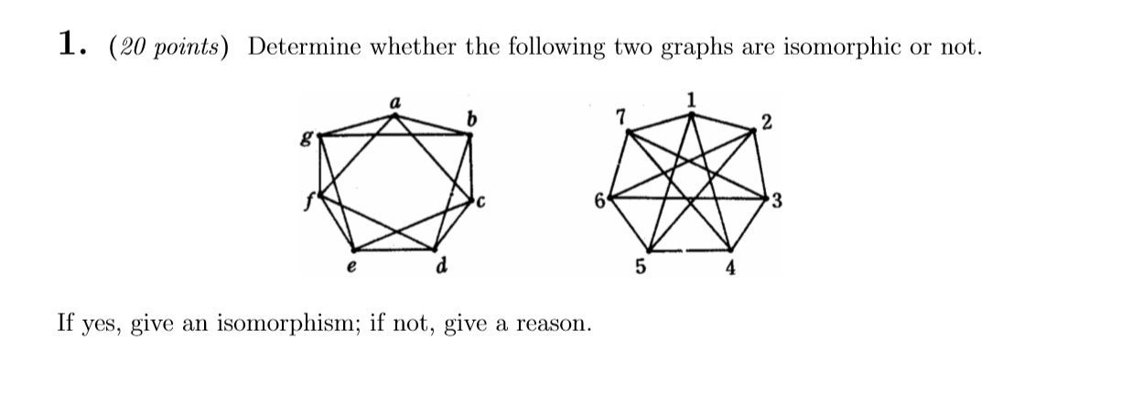
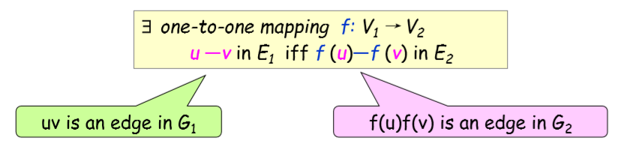

Slide 3
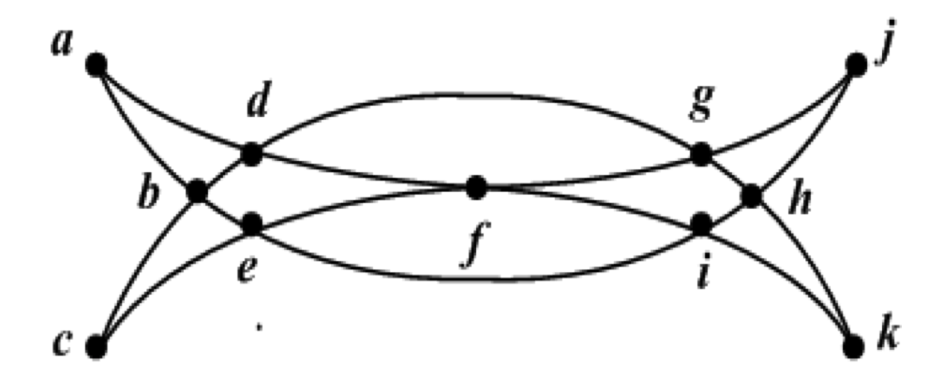
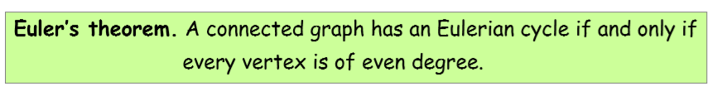
2. Is the following “Khanjar” an Eulerian Graph? If YES, find an Euler cycle. If NOT, explain.

Slide 4
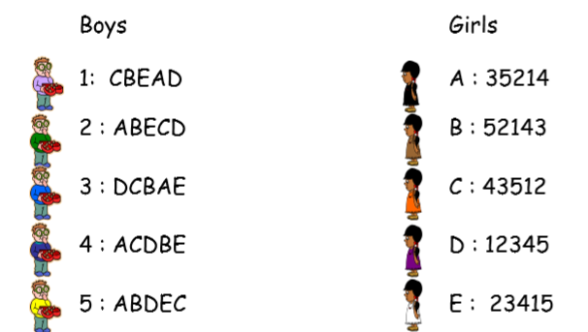
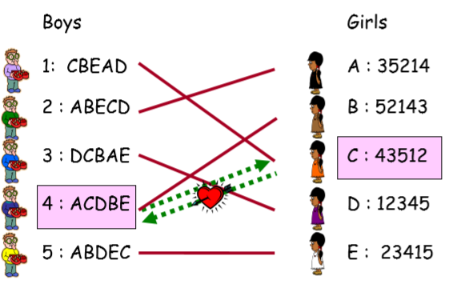
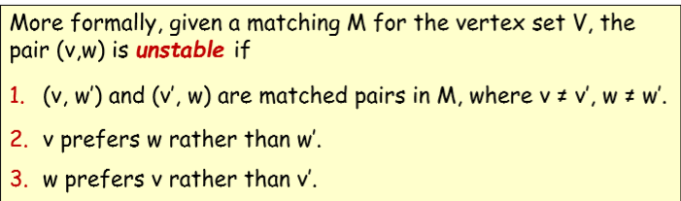

Slide 5
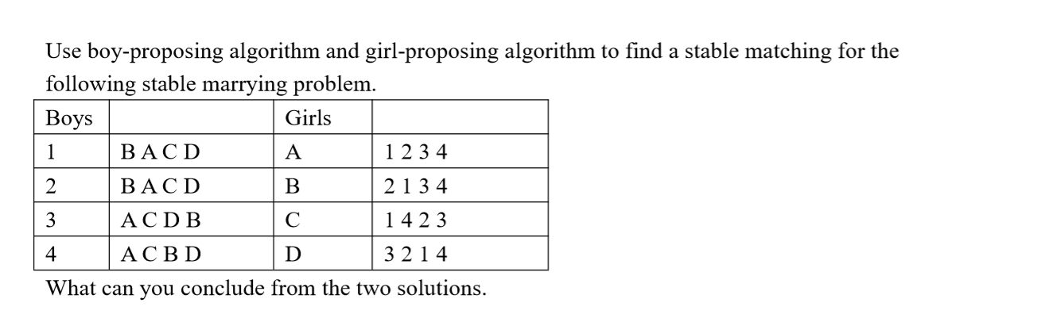
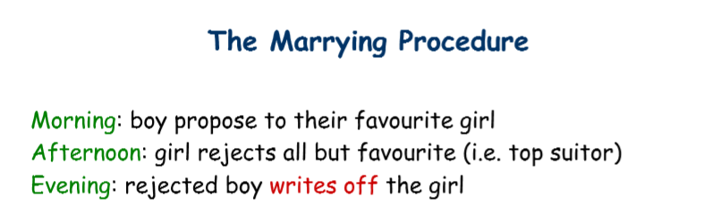

Slide 6
Since the boy-proposing process is boy optimal while the girl-proposing process is boy pessimal. So the partner of every boy in the first matching is the best partner while the one in the second matching is the worst partner. And since they are the same, we can conclude that there is only one valid girl for every boy. Similarly, there is also only one valid boy for every girl. So in this problem, the stable marrying matching is unique.

Slide 7
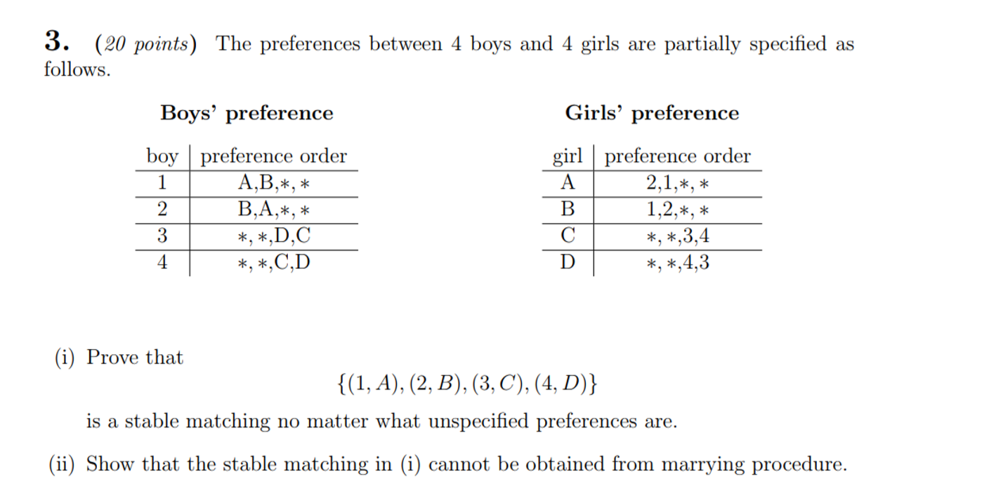

Slide 8
What we have learned…
1. Logic and Set
2. Proof I (basic, Invariant method, WOP)
3. Proof II (Mathematical induction)
4. Recursion
5. Greatest common divisors
6. Modular arithmetic (CRT)

Slide 9
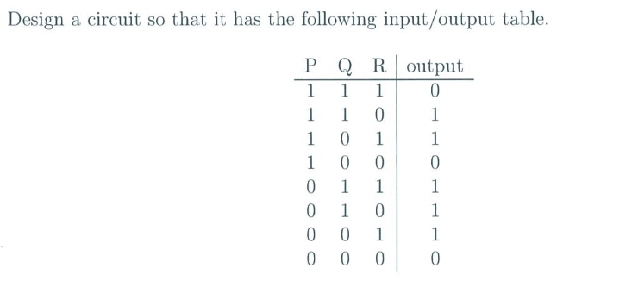

Slide 10
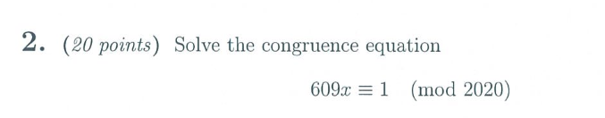

Slide 11
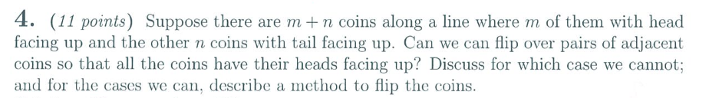

Slide 13
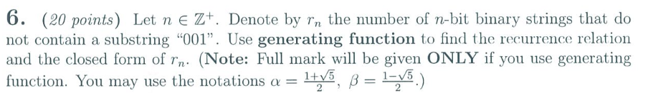
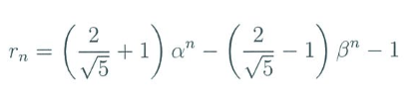

Slide 14
What we have tested…
1. Logic and Set
4. Proof I (basic, Invariant method, WOP)
5. Proof II (Mathematical induction)
6. Recursion
3. Greatest common divisors
2. Modular arithmetic (CRT)

